Slide 1



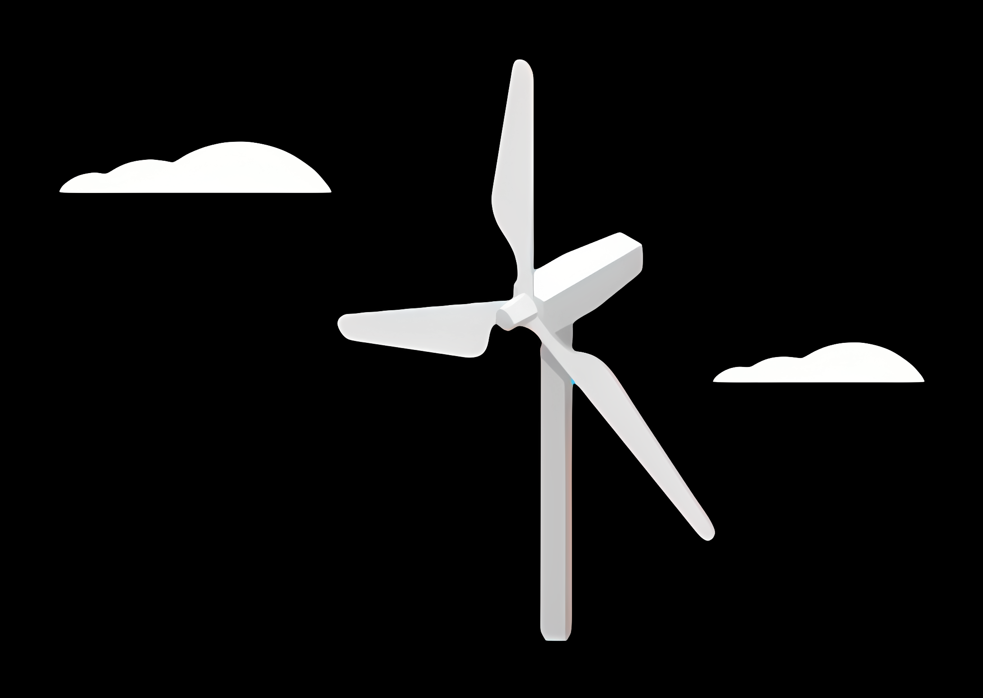
Weekly report: Team Project Development
Week number: 00 – Kick Off
Date: 23/09/2025
Supervisor: Dr. Marina Blohm
Group members: Luis Urhahn, Ahmed Sallam, Ceren Cetin, Sohail Mansuri

Slide 2
Tasks of the Summer Break
Given task by the University (team supervisor was not defined yet):
1. Get into contact with Damaskus University for specific corporation
2. Research on environmental, operational and legal conditions in Syria
Given task by the management team:
3. Find a suitable site for the Optimus Project in Syria, find reasanable values for:
Wind Resource Data
Grid Connection
Infrastructure
Topography
Soil Conditions
Legal Requirements

Slide 3
Our approach
I. Self-study on the topic and the country of Syria
II. Initial meeting with Mrs. Blohm
Getting a sight about how to choose a location.
III. Searching for possible areas, considering…
Wind resource availability (WindAtlas),
Grid connection (InfrastructureMap),
Land use and terrain (Maps+GoogleEarth),
Transportation (Maps),
General infrastructure (Maps),
Legal requirements,
Environmental impact.
IV. Comparison of suitable areas
Pros/Cons List for comparison
Final decision on one area
V. Finding a suitable/available site in the area
VI. Confirmation meeting with Mrs. Blohm

Slide 4
Sharing of Work
Luis Urhahn
Leading the team
Organising the Meetings and communications
Preparation of reports
Giving inputs to the site selection
Ahmed Sallam
No input, attended some meetings
Ceren Cetin
Giving inputs to the site selection
Preparing the presentation
Sohail Mansuri
Giving inputs to the site selection

Slide 5
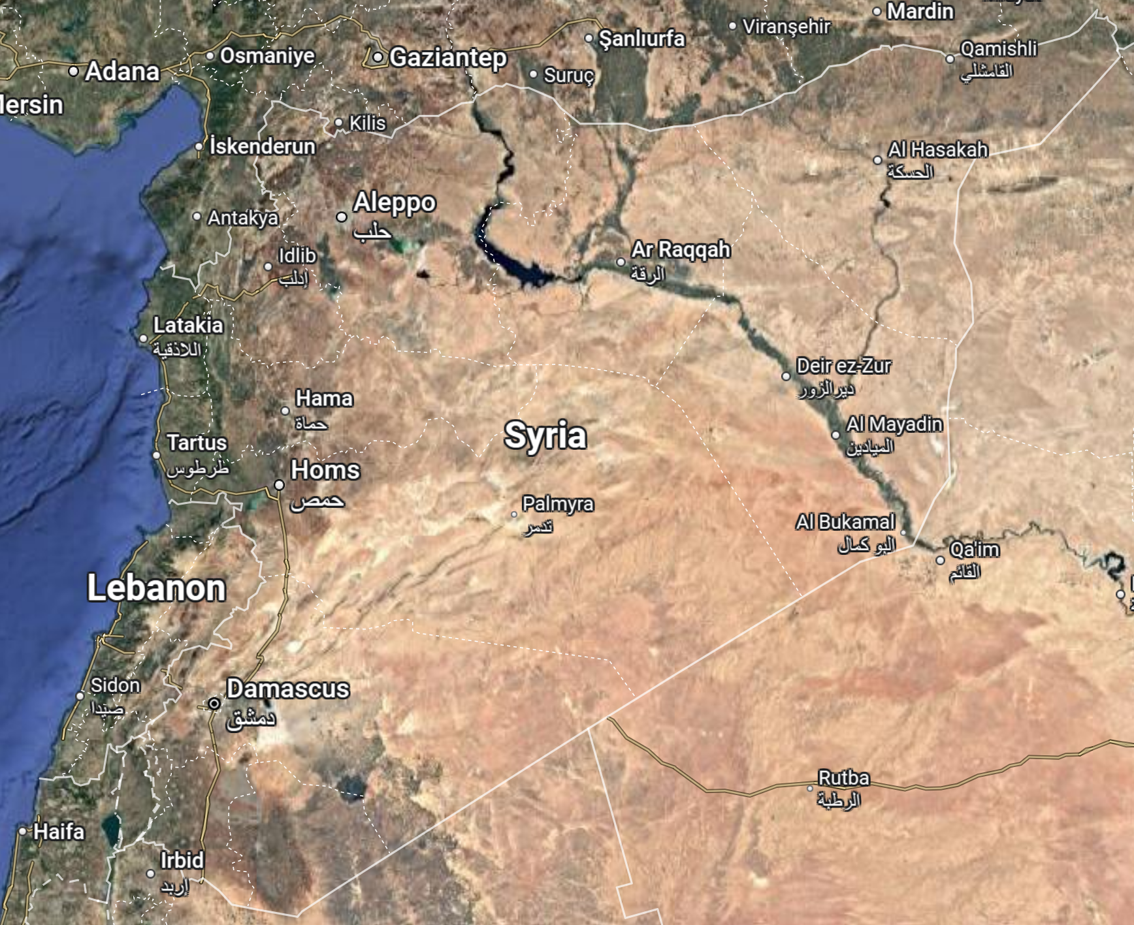
Considered Areas
Area of Maryamayn
Area of Latakia
Area of Ash Sholah
Area of Homs
Area of Barek
Area of
As Suwayda
Figure 1: Overview of Syria [3]

Slide 6
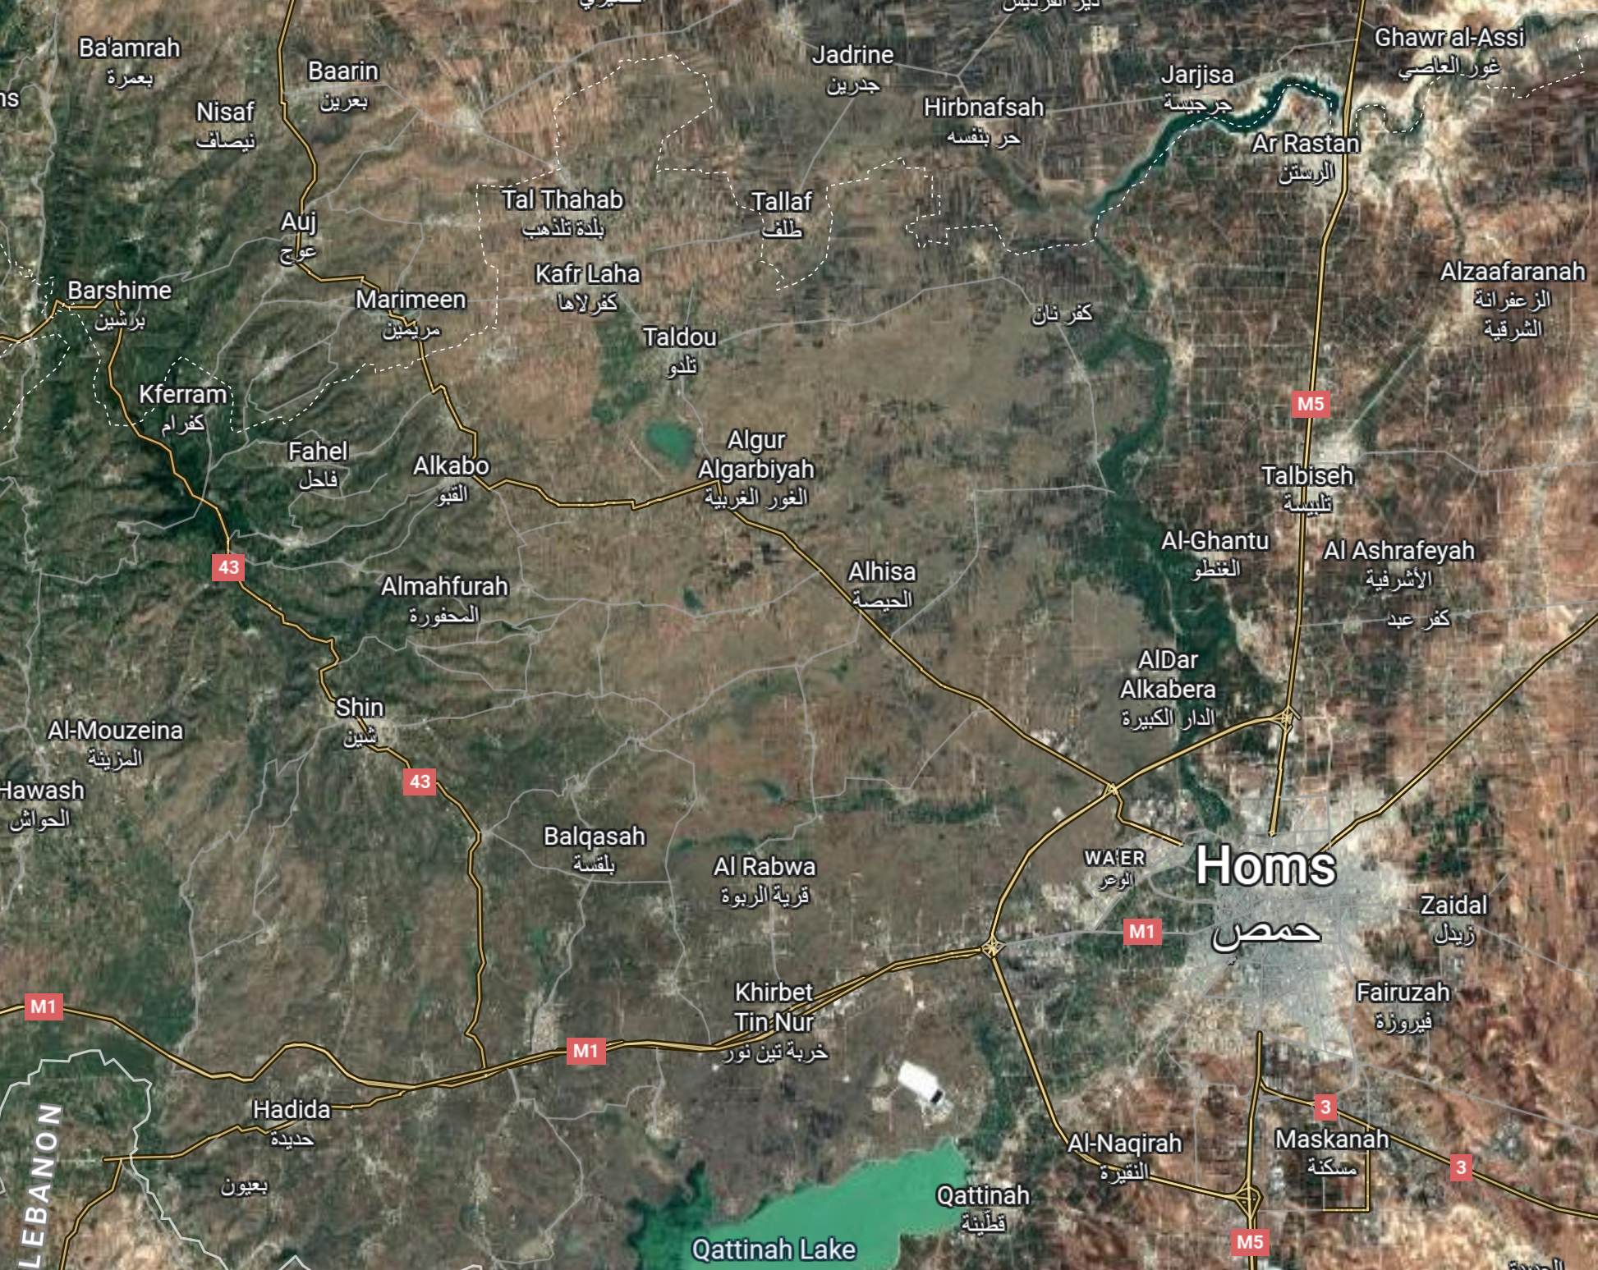
Considered Sites – Around Homs District
Site: Tareen
Site: Tbisah
Site: Sufr
Site: Balqasah
Site: Um Aledam
Figure 2: Overview of the Homs District [3]

Slide 7
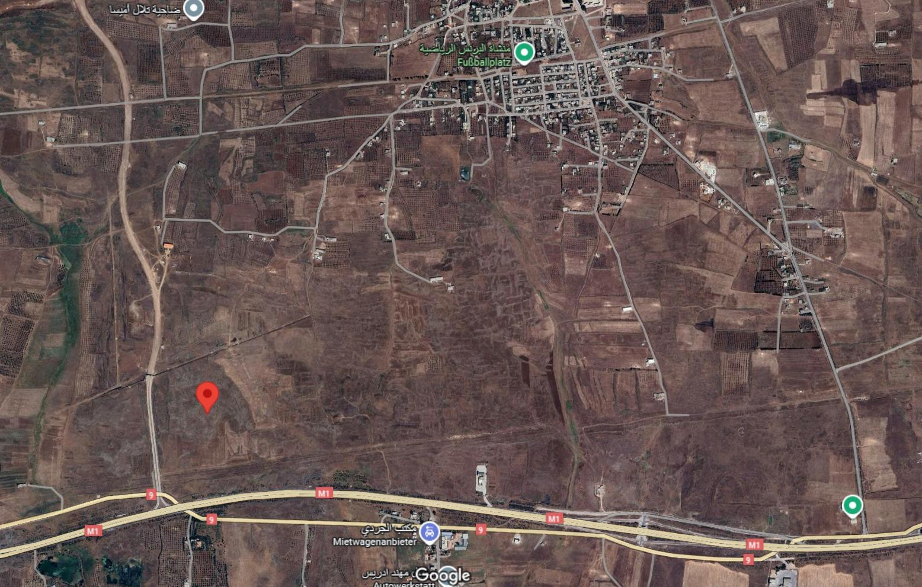

Characterisitcs of the Site – Um Aledam
Located on the countryside of Homs District
Located on the east side of the mountain range
Close access to the main road M1 (highway)
Free area, no farmland or private land (assumption)
Sufficient distance from surrounding buildings (main wind direction)
Existing wind turbines in the area (2 x 2.5 MW)
Latitude: 34° 41' 48.4" N Longitude: 36° 30' 32.5" E
Figure 3: Detailed view of the site [3]

Slide 8
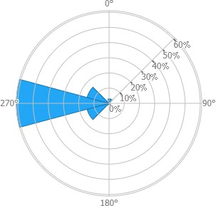
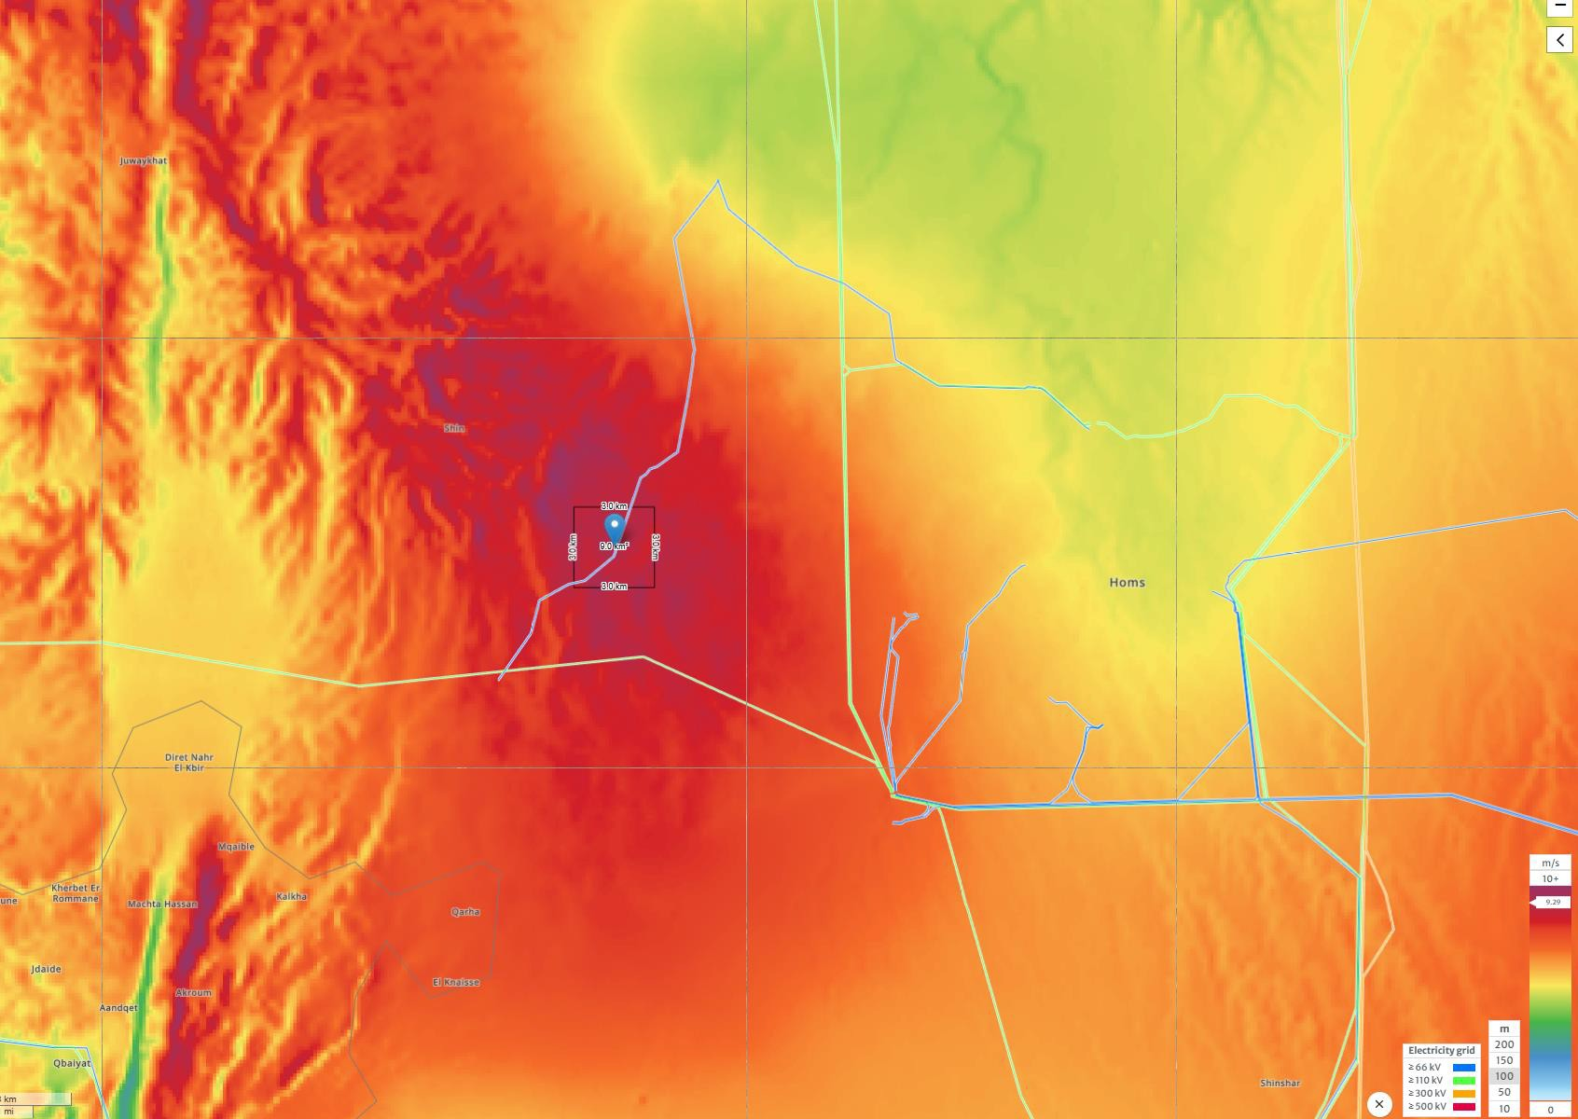
Wind Ressource Data – Um Aledam
Wind Data at HH 100m:
Main Wind Direction: 270° (West)
Average Wind Speed: 9.29 m/s
Wind Capacity: 824 W/m²
Wind Turbine Class: III A
Capacity Factor, IEC Class III: 0.58
→ FLH: 5 080 h
Turbulence Intensity: A
Figure 4: Windrose (Windspeed) [1]
Figure 5: Wind Map [1]

Slide 9
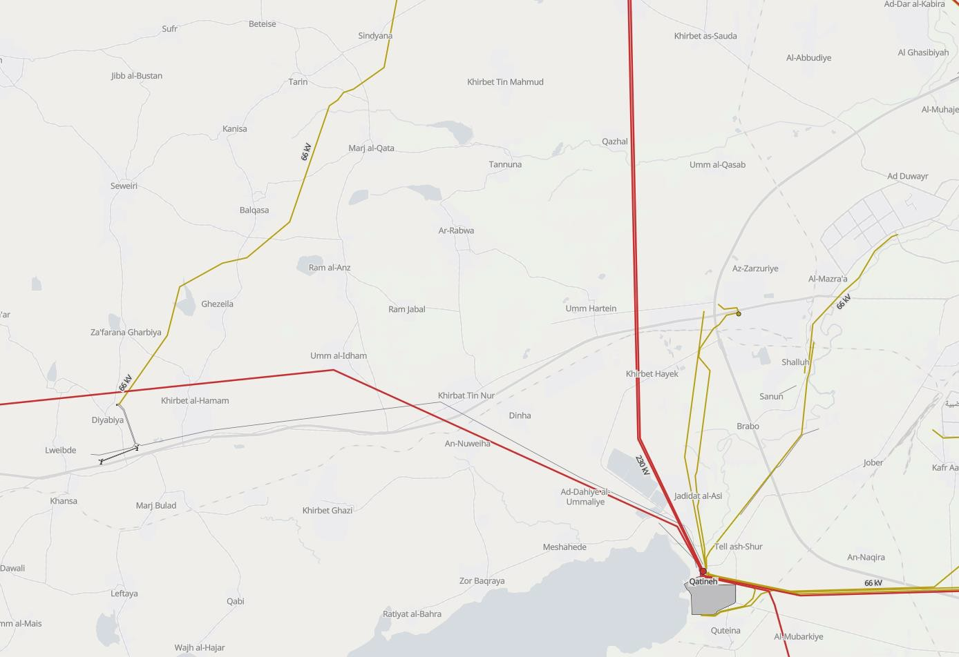



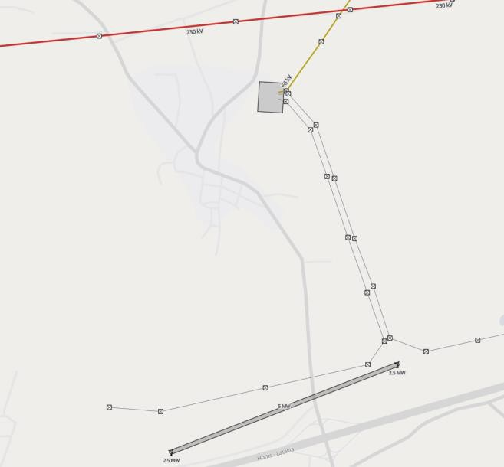




Grid Infrastructure – Um Aledam
Grid Connection (Substation) within 10 km distance
Connected to 66 kV Grid (Grid frequency 50 Hz)
Possibility for connection to 230 kV Grid
Close industry in the City of Homs
Final location of WT
Figure 6:
Grid Map [4]
Existing Substation
(66 kV Grid)
Existing 2x2.5MW WT
Figure 7:
Detailed view of Substation [4]

Slide 10
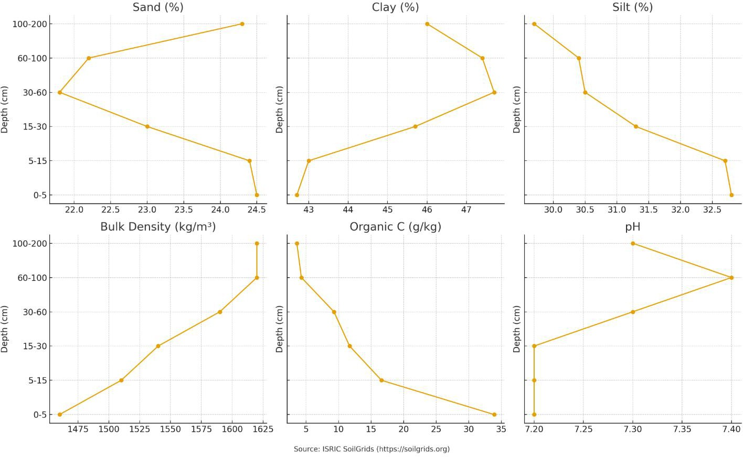
Soil Conditions – Um Aledam
Figure 8: Graph for Soil Conditions [5]

Slide 11
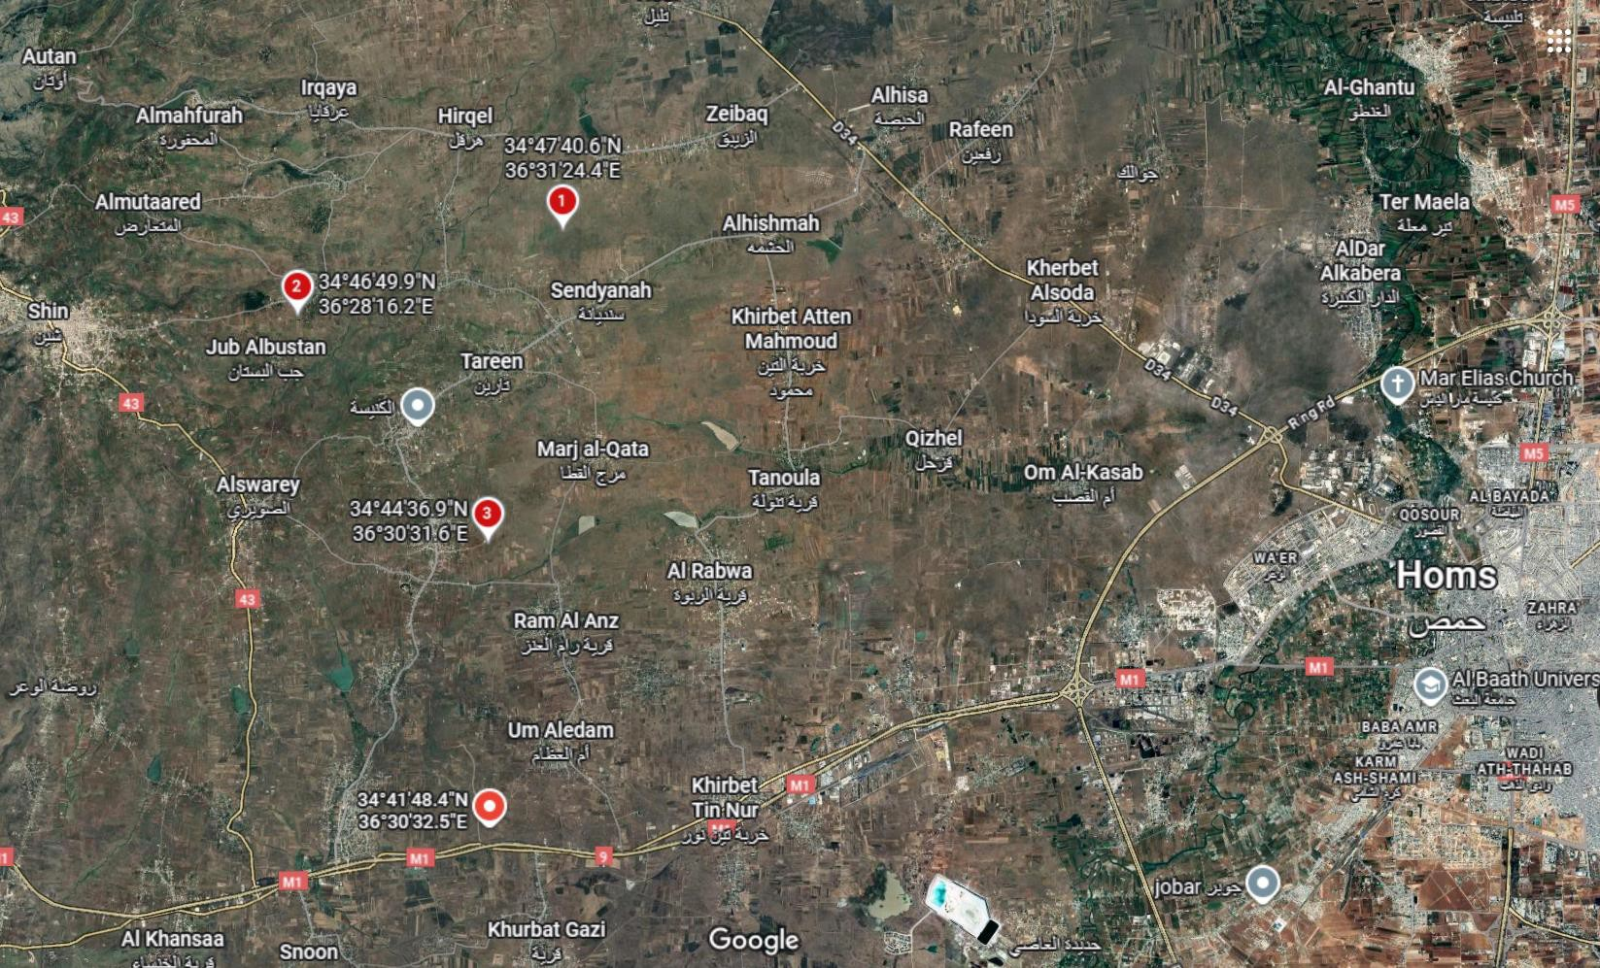
Alternative Locations – Homs District
Alternatives
Current final location
Figure 9: Alternative Sites in Homs District [3]
1. Tbisah
Location: 34.794617° N, 36.523435° E
Farmland, more in the country area
More far away from main street and grid
Slightly better wind conditions
2. Sufr
Location: 34.780536° N, 36.471176° E
In the mountains
More far away from main street and grid
Slightly better wind conditions
3. Balqasah
Location: 34° 44' 36.9" N 36° 30' 31.6" E
More in the countryside
No buildings around the area
More far away from main street and grid
Similar wind conditions

Slide 12
General Information of the Site – Um Aledam
Parameter | Value
Location | Latitude: 34° 41' 48.4" N Longitude: 36° 30' 32.5" E
Average Wind Speed | 9.29 m/s
Main Wind Direction | 270° (West) (more than 95% of the time)
Wind Capacity | 824 W/m²
Wind Turbine Class (IEC) | III A
Grid Connection | 66 kV (or 230 kV), 50 Hz
Substation | 66 kV Substation (approx. 10 km distance)
Air Temperature | ~ 20 °C (max. 37 °C, low. 4 °C)
Humidity | 42%
Air Pressure (Ground level) | 1006 mbar
Roughness length | 0,03
Orography (Terrain height) | 618 m
Environmental conditions | Mostly dry, Farmland, Flat Terrain
Road condition | Good (Highway M1)
Distance to Port | 85 km (Tartous Port)

Slide 13
References
[1] Global Wind Atlas, Global Wind Atlas. [Online]. Available: https://globalwindatlas.info/en/. [Accessed: Sep. 17, 2025].
[2] Google Earth, Google Earth Web. [Online]. Available: https://earth.google.com/web/@34.29977563,36.68817928,1384.78342427a,853580.17318904d,35y,0h,0t,0r/data=CgRCAggBOgMKATBCAggASg0I____________ARAA. [Accessed: Sep. 17, 2025].
[3] Google Maps, Google Maps. [Online]. Available: https://www.google.com/maps. [Accessed: Sep. 17, 2025].
[4] Open Infrastructure Map, OpenInfraMap. [Online]. Available: https://openinframap.org/#10.04/33.2058/36.2058. [Accessed: Sep. 17, 2025].
[5] Soilgrids, Soilgrids REST API - Swagger UI. [Online]. Available: https://soilgrids.org/?utm. [Accessed: Sep. 17, 2025].

